Slide 1
Graph Databases

Slide 2
What is a Graph Database
A database for storing, managing, and querying highly connected and complex data
It’s all about the relationships
The architecture makes it well-suited for exploring data to find commonalities and anomalies in large data volumes and unlocking the value in data relationships

Slide 3
Example Usage
Recommendation/Personalization
Recommending products, next actions, advertising based on user data, relationships, past behavior, and interactions
Customer 360
Understand business data and relationships consolidated across business units
Security and Fraud Detection
Find anomaly in an interrelated network of users, entities, transactions, events, and interactions
Asset Management
Analysis on relationships that form among assets and relationships with their properties and how they relate to each other over time.

Slide 4
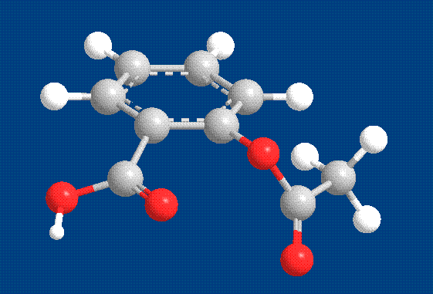
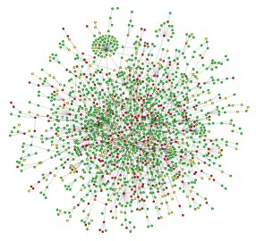
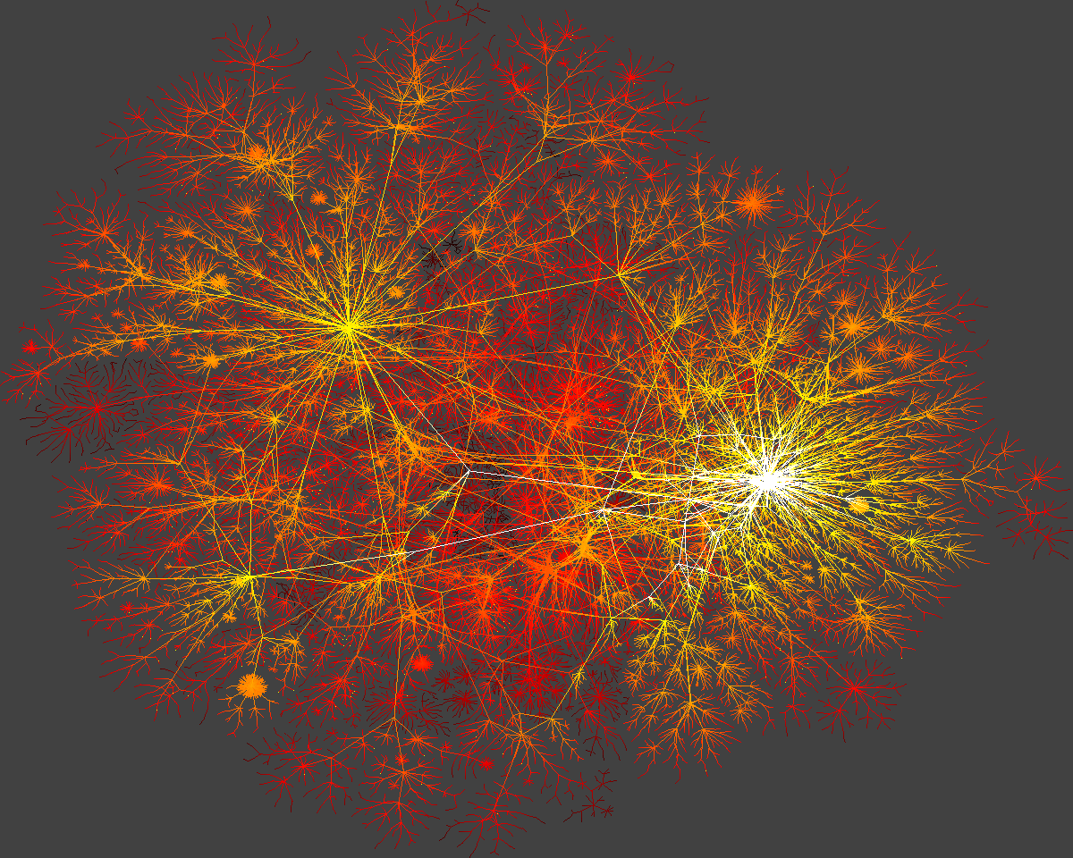
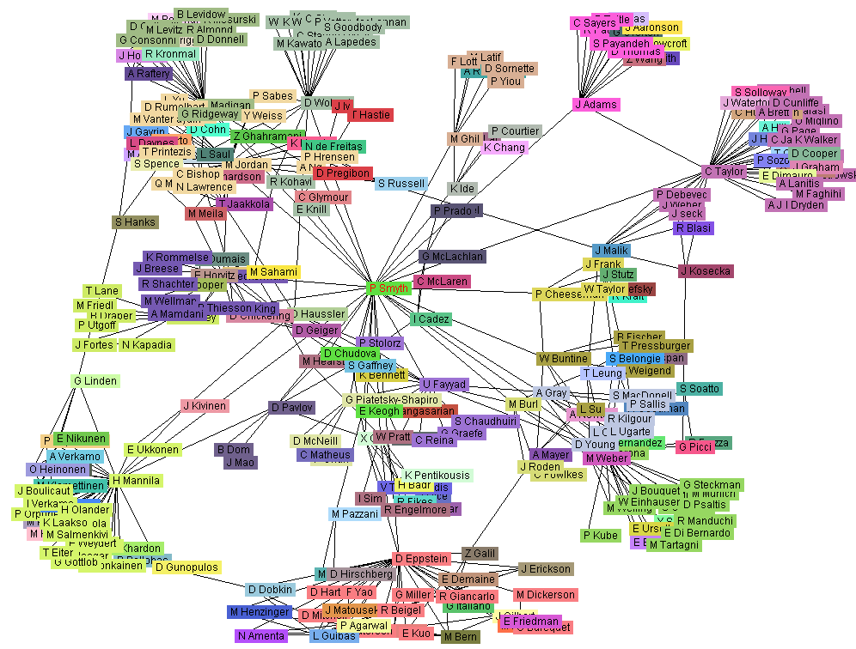
Graph, Graph, Everywhere
Relationships
Interactions
connections
from H. Jeong et al Nature 411, 41 (2001)
Chemical Properties
Yeast protein interaction network
Internet
Co-author network

Slide 5
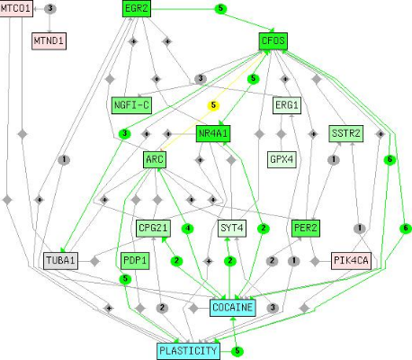
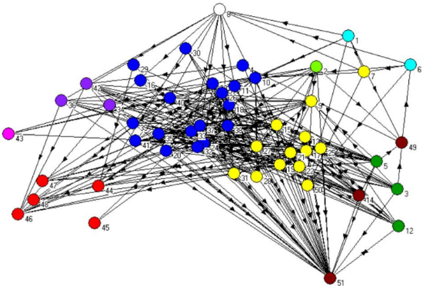
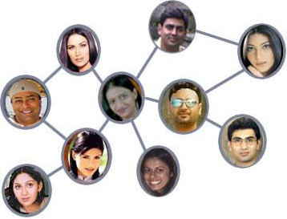
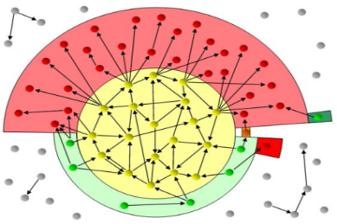
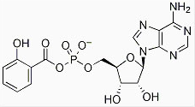
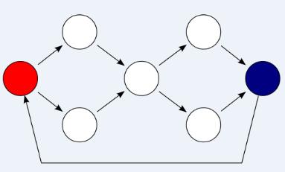
Graph Databases
Biological Network
Ecological Network
Social Network
Chemical Network
Program Flow
Web Graph

Slide 6
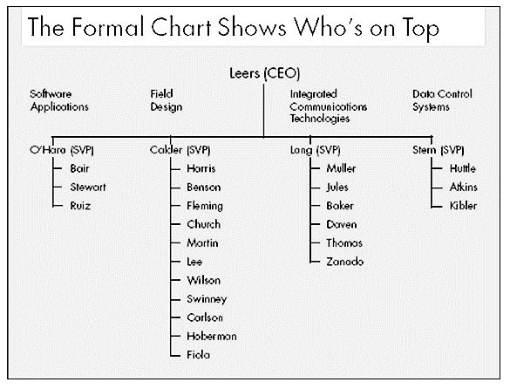
Motivating example
Courtesy of: “Informal Networks: The Company Behind the Chart,” Krackhardt and Hanson, Harvard Business Review 1993

Slide 7
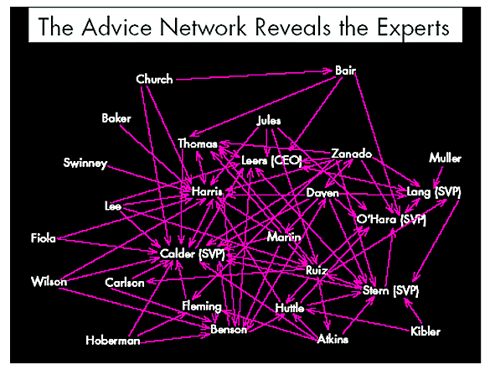
Alternative: Advice network

Slide 8
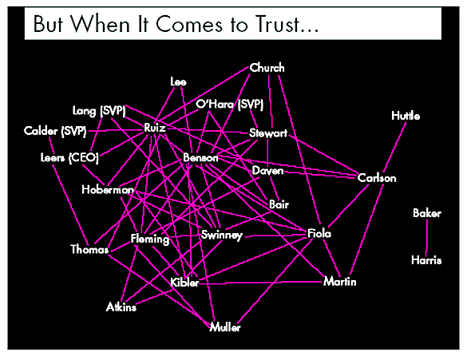
Alternative: trust network

Slide 9
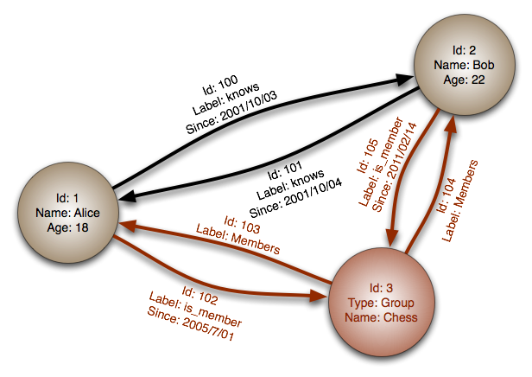
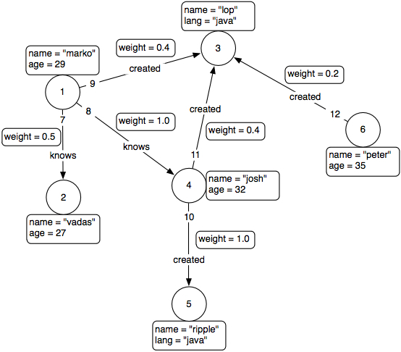
Fundamental graph modeling elements
Nodes
Represent Entities
Can have any number of properties
Can be queried according to properties
Relationships
Represent any kind of relationship
Also support any number of properties
Usually directed
Properties
Either nodes or relationships can have properties

Slide 10
Examples
Social Networks
People → People
Employees → Positions → Firms
Fraud Analysis
People → Accounts
Clinics → Claims → Physicians → Recipients
Sales
Salesperson → Deal → Product → Customer
Recommendation Engines
Dynamic, not batched operations
People → Products/Videos/Books

Slide 11
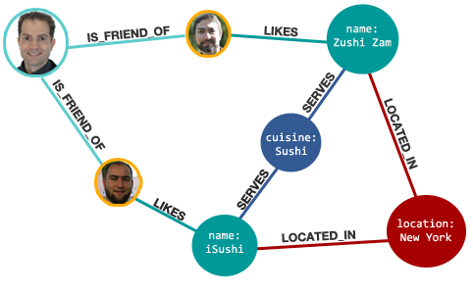
Graph Databases: Query
Find all the restaurants my friends (in Facebook) like

Slide 12
Friends of evelyn
MATCH (n)-[:FRIEND_OF]->(person:Person)
WHERE person.name = 'Evelyn'
return n,person;

Slide 13
Find all common friends - SQL
Table for people
Join table for friends
Foreign key Acct1 refers to people
Foreign key Acct2 refers to people
Select p1.name, p2.name, c.name from
people p1 join friends a on p1.id = a.Acct1
join people c on a.Acct2 = c.id
join friends b on a.Acct2 = b.Acct1
join people p2 on a.Acct2 = p2.id
order by p1.name, p2.name

Slide 14
Find all common friends
match (a)-[:FRIEND]->(b)<-[:FRIEND]-(c)
return a,c,b order by a.name, c.name
Passes through Data?
Disk?
map(A -> B C D) :
(A B) -> B C D
(A C) -> B C D
(A D) -> B C D
map(B -> A C D E) :
(A B) -> A C D E
(B C) -> A C D E
(B D) -> A C D E
(B E) -> A C D E
Etc.
Reduce
(A B) -> (A C D E) (B C D)
(A C) -> (A B D E) (B C D)
(A D) -> (A B C E) (B C D)
(B C) -> (A B D E) (A C D E)
(B D) -> (A B C E) (A C D E)
(B E) -> (A C D E) (B C D)
(C D) -> (A B C E) (A B D E)
(C E) -> (A B D E) (B C D)
(D E) -> (A B C E) (B C D)
The result after reduction is:
(A B) -> (C D)
(A C) -> (B D)
(A D) -> (B C)
(B C) -> (A D E)
(B D) -> (A C E)
(B E) -> (C D)
(C D) -> (A B E)
(C E) -> (B D)
(D E) -> (B C)

Slide 15
/Node

Slide 17
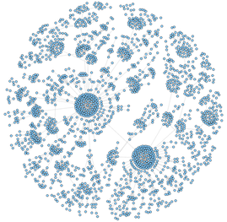
Case Study
A side by side comparison of a relational database and Neo4j
Artificially generated graph dataset with natural statistics
1 million vertices and 4 million edges

Slide 18
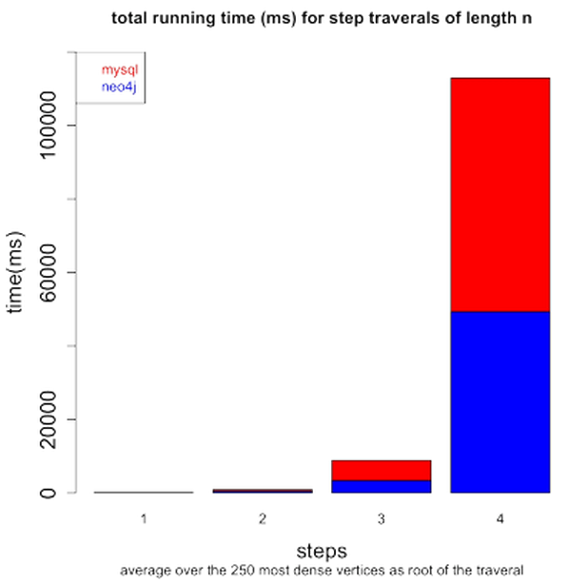
Case Study Results
First 250 vertices used as roots
Neo4j proved to take less than half the time of the SQL database.

Slide 19
Social Network “path exists” Performance
Experiment:
~1k persons
Average 50 friends per person
pathExists(a,b) limited to depth 4
Caches warm to eliminate disk IO
 | # persons | query time
Relational database | 1000 | 2000ms

Slide 20
Social Network “path exists” Performance
Experiment:
~1k persons
Average 50 friends per person
pathExists(a,b) limited to depth 4
Caches warm to eliminate disk IO
 | # persons | query time
Relational database | 1000 | 2000ms
Neo4j | 1000 | 2ms

Slide 21
Social Network “path exists” Performance
Experiment:
~1k persons
Average 50 friends per person
pathExists(a,b) limited to depth 4
Caches warm to eliminate disk IO
 | # persons | query time
Relational database | 1000 | 2000ms
Neo4j | 1000 | 2ms
Neo4j | 1000000 | 2ms

Slide 22
Introduction to the graph model
Property Graph
Nodes (“vertices”)
Relationships (“edges”)
Properties
Notes:
1“A property graph is made up of nodes, relationships, and properties.
• Nodes contain properties. Think of nodes as documents that store properties in the
form of arbitrary key-value pairs. The keys are strings and the values are arbitrary
data types.
• Relationships connect and structure nodes. A relationship always has a direction,
a label, and a start node and an end node—there are no dangling relationships.
Together, a relationship’s direction and label add semantic clarity to the structuring
of nodes.
• Like nodes, relationships can also have properties. The ability to add properties to
relationships is particularly useful for providing additional metadata for graph”

Slide 23
Introduction to the Graph Model
Nodes
Nodes represent entities
Nodes contain properties. Think of nodes as documents that store properties in the form of arbitrary key-value pairs.

Slide 24
Introduction to the Graph Model
Relationships
Relationships are the lines/edges between nodes.
Relationships connect and structure nodes. Must have a start and end
Notes:
Graph Databases are highly connected data model. Relationships are cheap.
A relationship must have a start node and an end node. No more, no less.
Relationships can come and go as the domain is built out.
Relationships for the business domain.
Relationships for the different queries.
In a way you could think of it as a cube with each level of the cube containing different relationships. (Don’t actually build that much complexity)
A relationship is a first class citizan

Slide 25
Introduction to the Graph Model
Properties
Properties are values about the node or relationship.
Properties can also be added to nodes and relationships.
Allows you to create additional semantics to relationships.
Both nodes and edges are documents.
Notes:
Each properties is a key/value
Everybody gets a property (Nodes/Relationships) Not get but can.

Slide 26
Introduction to the graph model
Basic Graph

Slide 27
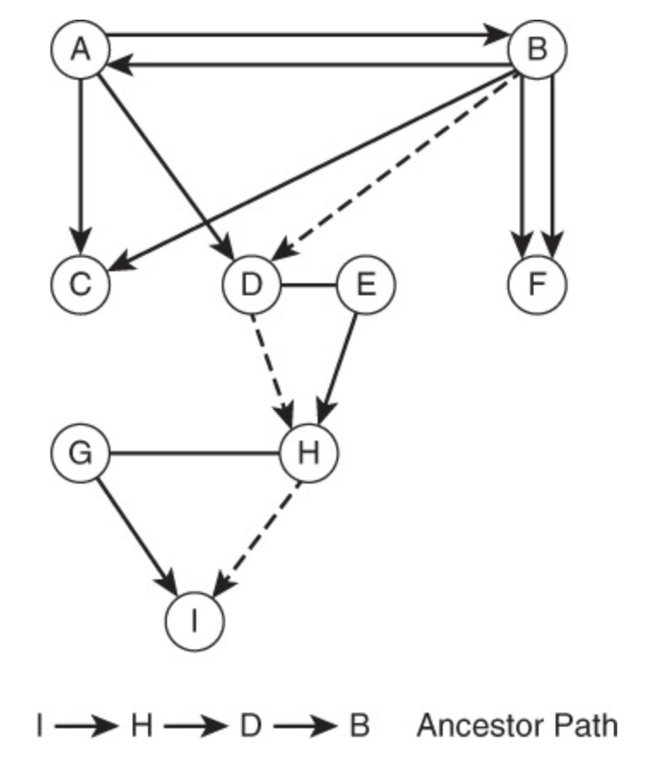
Introduction to the Graph Model
Path – a set of vertices along with the edges between those vertices.
directed and undirected
capture information about how vertices are related
-- Find the least weighted or shortest path between two vertices

Slide 28
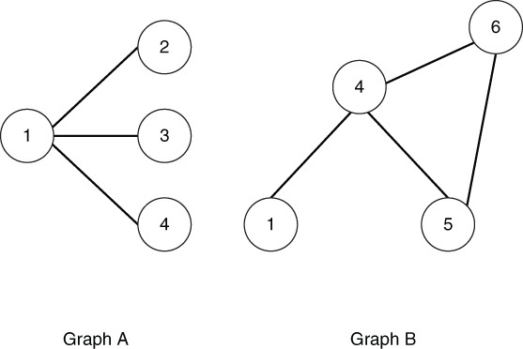
Introduction to The Graph Model - Operations
Union
Combined set of vertices and edges
Intersection
Common edges and vertices
Graph Traversal
Visit the vertices and edges in a particular way

Slide 29
Introduction to the Graph Model - Properties
Isomorphism – graph equality
Two graphs are considered isomorphic is for each vertex in the first graph, there is a corresponding vertex in the other graph and for each edge between a pair of vertices in the first graph, there is a corresponding edge in the second graph.
Order – number of vertices
Size – number of edges
Degree – number of edges linked to a vertex
in-degree
out-degree
Closeness – how far a vertex is from all others
Betweenness – how much of a bottleneck a given vertex is

Slide 30
Introduction to the Graph Model - Types
Flow Network
Bipartite Graph

Slide 31
Data Modeling with Graph Databases
Graph Database:
“A graph database management system (G-DBMS) is an online database management system with Create, Read, Update, and Delete (CRUD) methods that expose a graph data model.”

Slide 32
Data Modeling with Graph Databases
Performance
Performance increase when dealing with connected data.
Flexibility
We can add nodes/relationships as the business domain dictates.
Agility
Agile and test-driven software development practices.
Notes:
Performance better when multiple joins
Performance Queries are localized within the graph
There are flexibility issues regarding the transition of relationships into nodes
Flexibility could be better in hypergraphs.
Agility can leverage the schema and subgraph capabilities, and the API/Query allows for testability.

Slide 33
Data modeling with graph databases
Q: Why use a graph database?
#1: It is all about the relationships.
#2: First learn #1.
A: Here is the simplified answer.
Notes:
My requirement was to find matches. (Relationships)
I had people telling me that we would have implemented a NoSQL solution. My first question was what is the benefit. Answer, there is no schema… we can just load the data. Ok. First hurdle is over. Then what? Then we define the schema. (At some point we have to do work)
I did not have to worry about the app development. I did however try to be a good data steward.

Slide 34
Introduction to the graph model
Graph Structure

Slide 35
Data Modeling with Graph Databases
Graph Modeling Rules: “By the book¹”
Nodes for Things, Relationships for Structure
Use nodes to represent entities –things of interest
Use relationships to build structure
Use node properties to represent entity attributes, plus metadata
Express connections between entities
Establish semantic context for each entity
Use relationship properties to express the strength, weight, or quality of a relationship, plus metadata.
Notes:
First gold star. If you wanted to print some slide, then I identified the 4 slides you will most likely want.
1st star is the Rules

Slide 36
Introduction to the graph model
How do you use a graph database?
Traversal of the database.
Query
Follow the relationships from node to node
Result Options
A set
A path
A pattern
Notes:
“Walk on the path” sign, or walk on the stepping stones.
“Walk through the network”
Traversal
Any familiar with the hierarchical data type? Very similar.
Accidentally created a graph database with the hierarchical data type.
A pattern of nodes/relationships… Think clickstream analysis or Action/Result

Slide 37
Introduction to the graph model
Set
Path
Pattern
Notes:
Each result can be a node/relationship
Set: Query just the green
Path: Query starting at purple find the path to Orange
Pattern: Query green-blue combo.

Slide 38
Relational and graph models
Similarities
Define and agree upon the domain entities
Define the interactions, and governing rules
Whiteboard stage is the same
Differences
Few changes from conceptual to logical to physical
Graphs storage model matches the logical model
After the initial domain definition we enhance the graph instead of defining the tables.

Slide 39
Relational and graph models
Relational
every node has a direct pointer to its adjacent elements and no index lookups are necessary
Graph
Notes:
Adjacency: every node has a direct pointer to its adjacent elements and no index lookups are necessary.

Slide 40
Healthcare use case
Accountable Care Organizations (ACOs)
Patient Protection and Affordable Care Act of 2010
Transform health providers into ACOs
What is the result?
What does this boil down to?
Patient Matching
Each ACO has different information about the patients.
What is needed?
We need to know what is being done for a patient.

Slide 41
Healthcare use case
Patient Matching
Two specific objectives
Identify common attributes
Define processes and best practices
Scope of Problem
Up to 14% percent of medical records contain erroneous data
Notes:
Identify common attributes that achieve high positive match rates across disparate systems. The attributes may include common fields such as name, date of birth, address, sex, cell, emergency contact, insurer, etc…
Define processing and best practices that are the most effective to support high positive patient matching rates utilizing these attributes.
HIMSS also issued a 2009 white paper titled: Patient Identity Integrity; A White Paper by the HIMSS Patient Identity Integrity Work Group. Between 8 and 14 percent of electronic health records have patient identity errors, according to a 2008 RAND Corporation study of the issue. These errors are a major patient safety issue and cost driver. Misidentifying patients, incomplete records, multiple records for the same patient, more than one patients’ information in the same record, false negative and false positive identifications are safety and quality of care issues and totally unacceptable. Additionally, healthcare organizations, payers, and the government spend millions of dollars annually correcting these errors.
DQS, MDS solutions

Slide 42
Healthcare use case
Master Data Lookup
FirstName
LastName
DOB
Gender
SSN
Address1
Notes:
DQS (Correct, Corrected, Suggested, New, Invalid) in-graph indices
MDM lookup (Match, No Match, Overmatch)

Slide 43
Healthcare use case
Normalization
Notes:
Keep in mind that I have to be able to send back the original information to the originator.

Slide 44
Healthcare use case
matching site based on social graph database example
Notes:
The node are created alphabetically. Which means I created a standard naming conventions. (At least internally)
Linkedin Social Graph + Match.com Dating Graph = Patient Identity Graph

Slide 45
Neo4j

Slide 46
What is Neo4j?
Graph Database
Embeddable and server version
Full ACID transactions
Schema free, bottom-up data model design
Notes:
We are enterprise militants!
Acid always
Java first
Tens nEnterprise first
ot hundreds in a cluster
For highly connected data models – we’re not a KV store
We are GPL’d – you can use us for free if you can use MySQL for free

Slide 47
Cypher Query Language
Declarative graph pattern matching language
“SQL for graphs”
Tabular results
Cypher is evolving steadily
Syntax changes between releases
Supports queries
Including aggregation, ordering and limits
Mutating operations in product roadmap

Slide 48
Cypher query language
“ASCII ART”
( ) indicates node
--> or -[]-> indicates relationship
Supports CREATE, MATCH, shortestPath(), and more
MATCH assigns variables to nodes and relationships based on pattern matching
Can return nodes, relationships, or properties
Can execute functions

Slide 49
CYPHER EXAMPLE
MATCH (n1)-[:FRIEND_OF]->(n2)-[:FRIEND_OF]->(person:Person)
WHERE person.name = 'Evelyn’
RETURN n1,n2,person;

Slide 50
Example Query
Movies Tom Hanks acted in and their directors:
match (tom:Person {name:"Tom Hanks"})-[:ACTED_IN]->(m)<-[:DIRECTED]-(director)
return m.title, director.name order by director.name

Slide 51
Results
m.title | director.name
"A League of Their Own" | "Penny Marshall"
"Cloud Atlas" | "Tom Tykwer"
"Cloud Atlas" | "Lana Wachowski"
"Cloud Atlas" | "Lilly Wachowski"
"The Da Vinci Code" | "Ron Howard"
"Sleepless in Seattle" | "Nora Ephron"
"The Polar Express" | "Robert Zemeckis"
"The Green Mile" | "Frank Darabont"
"Cast Away" | "Robert Zemeckis"
"Charlie Wilson's War" | "Mike Nichols"
"That Thing You Do" | "Tom Hanks"
"Joe Versus the Volcano" | "John Patrick Stanley"
"Apollo 13" | "Ron Howard"
"You've Got Mail" | "Nora Ephron"
m.title | director.name
"The Green Mile" | "Frank Darabont"
"Joe Versus the Volcano" | "John Patrick Stanley"
"Cloud Atlas" | "Lana Wachowski"
"Cloud Atlas" | "Lilly Wachowski"
"Charlie Wilson's War" | "Mike Nichols"
"Sleepless in Seattle" | "Nora Ephron"
"You've Got Mail" | "Nora Ephron"
"A League of Their Own" | "Penny Marshall"
"The Polar Express" | "Robert Zemeckis"
"Cast Away" | "Robert Zemeckis"
"The Da Vinci Code" | "Ron Howard"
"Apollo 13" | "Ron Howard"
"That Thing You Do" | "Tom Hanks"
"Cloud Atlas" | "Tom Tykwer"

Slide 52
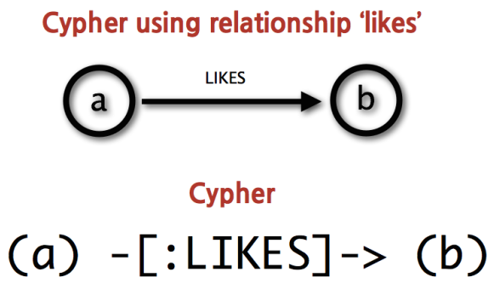
The Structure of a Cypher Query
Nodes are surrounded with parentheses which look like circles, e.g. (a)
A relationship is basically an arrow --> between two nodes with additional information placed in square brackets inside of the arrow
A query is comprised of several distinct clauses, like:
MATCH: The graph pattern to match. This is the most common way to get data from the graph.
WHERE: Not a clause in its own right, but rather part of MATCH, OPTIONAL MATCH and WITH. Adds constraints to a pattern, or filters the intermediate result passing through WITH.
RETURN: What to return.
MATCH (john {name: 'John'})-[:friend]->()-[:friend]->(fof) RETURN john.name, fof.name
http://www.peikids.org/what-we-do/ourmission/attachment/paint-hands/

Slide 53
Cypher Queries
Node labels, relationship types and property names are case-sensitive in Cypher
CREATE creates nodes with labels and properties or more complex structures
MERGE matches existing or creates new nodes and patterns. This is especially useful together with uniqueness constraints.
DELETE deletes nodes, relationships, or paths. Nodes can only be deleted when they have no other relationships still existing
DETACH DELETE deletes nodes and all their relationships
SET sets values to properties and add labels on nodes
REMOVE removes properties and labels on nodes
ORDER BY is a sub-clause that specifies that the output should be sorted and how

Slide 54
Node Syntax
()
(matrix)
(:Movie)
(matrix:Movie)
(matrix:Movie {title: ’The Matrix’})
(matrix:Movie {title: 'The Matrix', released: 1997})
Anonymous node
Node with a variable name
A particular kind of node – label
Variable name and label
Also particular node based on property
More properties to further distinguish

Slide 55
Relationship Syntax
--
-->
[]
-[role]->
-[:ACTED_IN]->
-[role:ACTED_IN]->
-[role:ACTED_IN {roles: [‘Neo’]}]->
(a)-[*2]->(b)
(a)-[:ACTED_IN*3..5]-(b)
Undirected relationship
Directed relationship
Added details
Directed with variable name
Directed of the type ACTED_IN
With a variable
More specific
Path of length 2
Path of length 3-5 through ACTED_IN relationships - Undirected

Slide 56
Patterns
Combine node and relationship
()-[]->()
(keanu:Person {name: 'Keanu Reeves'})-[role:ACTED_IN {roles: ['Neo']}]->(matrix:Movie {title: 'The Matrix’})
Can save a pattern in a variable
acted_in = (:Person)-[:ACTED_IN]->(:Movie)

Slide 57
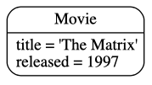
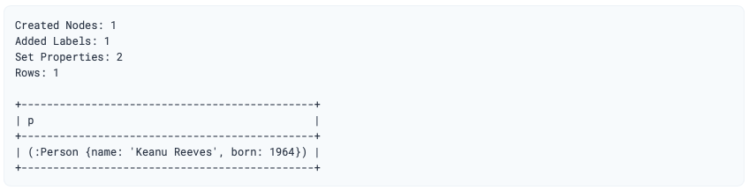
Create
CREATE ()
CREATE (:Movie {title: 'The Matrix', released: 1997})
Creates a node with label Movie that has title and released properties
If you want to see what happened use RETURN
CREATE (p:Person {name: 'Keanu Reeves', born: 1964})
RETURN p

Slide 58
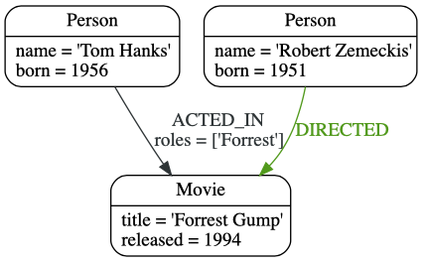
Create
CREATE (a:Person {name: 'Tom Hanks', born: 1956})-[r:ACTED_IN {roles: ['Forrest']}]->(m:Movie {title: 'Forrest Gump', released: 1994})
CREATE (d:Person {name: 'Robert Zemeckis', born: 1951})-[:DIRECTED]->(m)
RETURN a, d, r, m

Slide 59
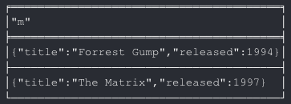
MATCH
Search for a pattern and return one row per successful match
MATCH(m:Movie)
RETURN m

Slide 60
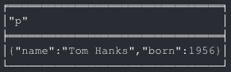
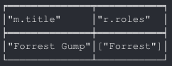
MATCH
Look for a specific person
MATCH(p:Person {name: 'Tom Hanks'})
RETURN p
Look for movies he acted in and what role
Role is a relationship property based on what we defined
MATCH (p:Person {name: 'Tom Hanks'})-[r:ACTED_IN]->(m:Movie) RETURN m.title, r.roles

Slide 61
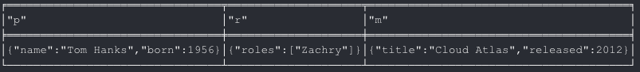
Adding to the graph
Match existing nodes and use that to make connections
MATCH (p:Person {name: 'Tom Hanks'})
CREATE (m:Movie {title: 'Cloud Atlas', released: 2012})
CREATE (p)-[r:ACTED_IN {roles: ['Zachry']}]->(m)
RETURN p, r, m

Slide 62
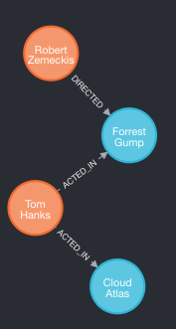
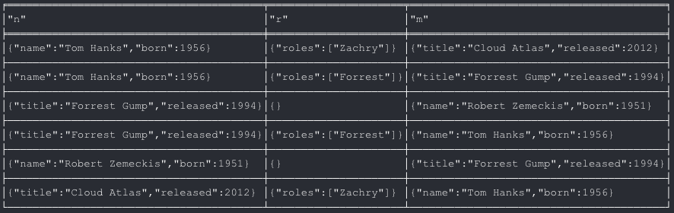
Show the whole thing
MATCH (n)-[r]-(m) RETURN n,r,m

Slide 63
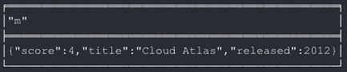
Adding more to existing nodes
MATCH and then SET
match(p:Person)-[r:ACTED_IN]->(m:Movie {title: 'Cloud Atlas’})
set m.score = 4
return m

Slide 64
Adding more to existing nodes
MERGE
MATCH (m:Movie {title: 'Cloud Atlas’})
MATCH (p:Person {name: 'Tom Hanks’})
MERGE (p)-[r:ACTED_IN]->(m)
ON CREATE SET r.roles =['Zachry’]
RETURN p, r, m
ON CREATE
Only set the value if the relationship doesn’t exist

Slide 65
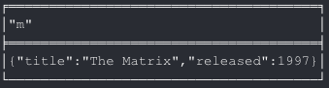
WHERE
Filtering results
MATCH (m:Movie) WHERE m.title = 'The Matrix' RETURN m

Slide 66
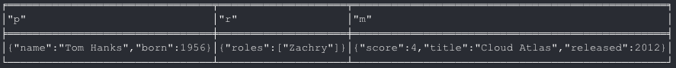
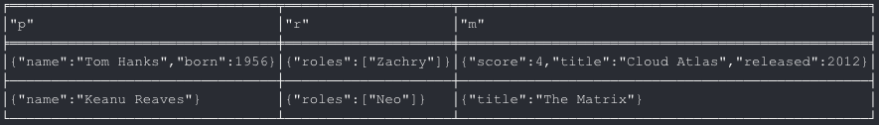
WHERE
=~ allows for
regex matching
Can be much more expressive
MATCH (p:Person)-[r:ACTED_IN]->(m:Movie)
WHERE p.name =~ 'K.+' OR m.released > 2000 OR 'Neo' IN r.roles
RETURN p, r, m
Now add Keanu
CREATE(m:Movie {title: “The Matrix”})
CREATE (k:Person {name: ”Keanu Reaves”})
CREATE (k)-[r:ACTED_IN {roles: [‘Neo’]}]->(m)
Return m, r, k
Then rerun the first query to show the use of the regex

Slide 67
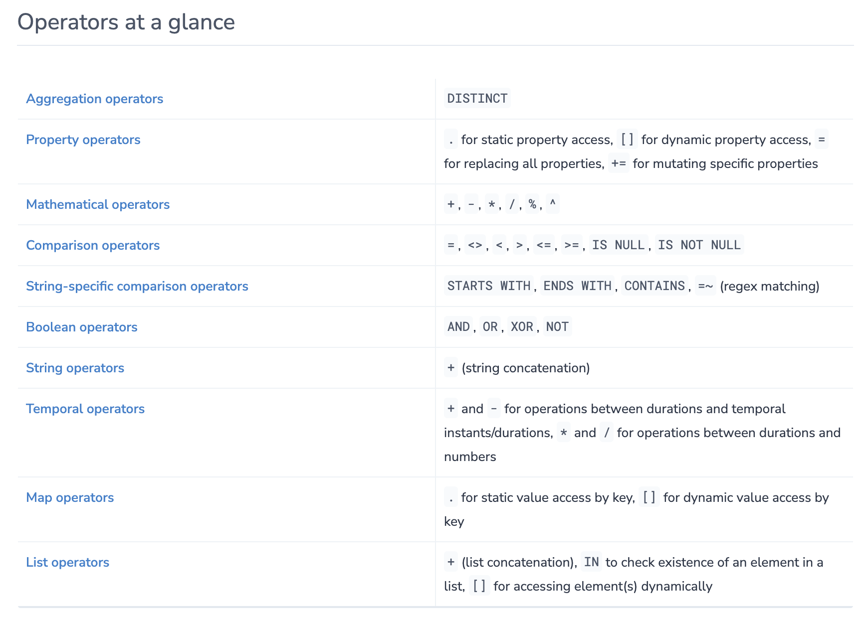

Slide 68
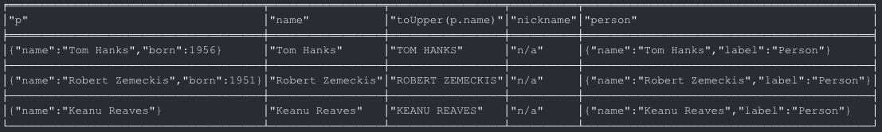
Returning Results
Can be much more expressive than we have been
MATCH (p:Person)
RETURN p,
p.name AS name,
toUpper(p.name),
coalesce(p.nickname, 'n/a') AS nickname,
{name: p.name, label: head(labels(p))} AS person
coalesce() returns the first non-null value in the given list of expressions.

Slide 69
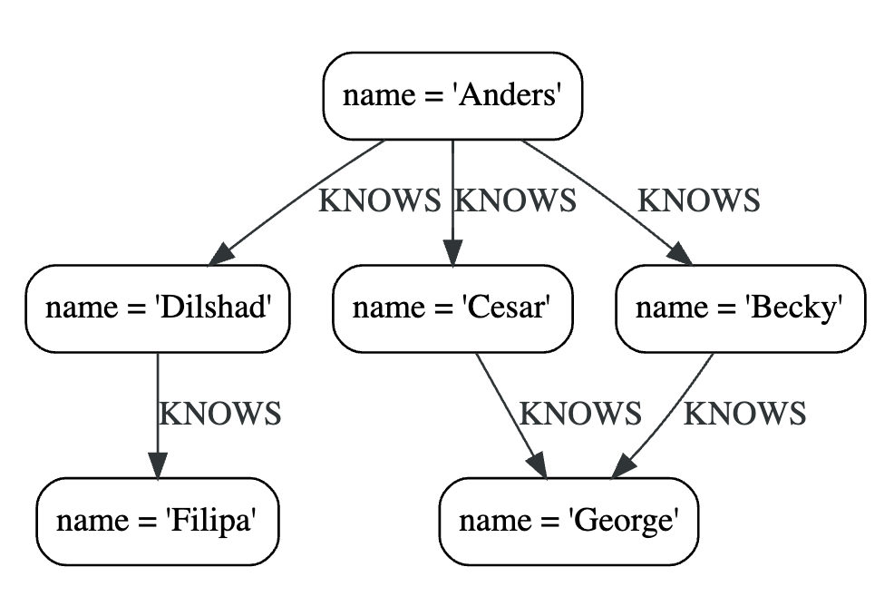
MATCH with path lengths
MATCH (me)-[:KNOWS*1..2]-(remote_friend)
WHERE me.name = 'Filipa'
RETURN remote_friend.name
remote_friend.name
"Dilshad"
"Anders"

Slide 70
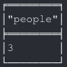
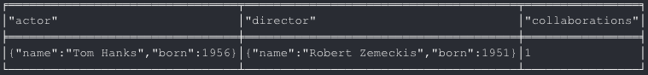
Aggregations
COUNT, SUM, AVG, MAX, MIN, COLLECT
MATCH (:Person) RETURN count(*) AS people
MATCH (actor:Person)-[:ACTED_IN]->(movie:Movie)<-[:DIRECTED]-(director:Person)
RETURN actor, director, count(*) AS collaborations

Slide 71
Order and pagination
Order by
MATCH (a:Person)-[:ACTED_IN]->(m:Movie)
RETURN a, count(*) AS appearances
ORDER BY appearances DESC LIMIT 10
Pagination is done using the
SKIP {offset} and
LIMIT {count} clauses.

Slide 72
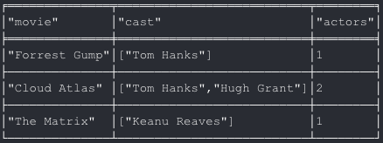
Collecting Aggregation
Collect function collects all the aggregated values into a list
Example
CREATE (p:Person {name: “Hugh Grant”})
CREATE (p)-[r:ACTED_IN]->(m:Movie {title: “Cloud Atlas”})
Return p, r, m
MATCH (m:Movie)<-[:ACTED_IN]-(a:Person)
RETURN m.title AS movie, collect(a.name) AS cast, count(*) AS actors

Slide 73
Functions
There are many functions available
Predicate functions
all(), any(), exists(), isEmpty(), none(), single()
Scalar functions
head(), last(), length(), properties(), size() …
Aggregating functions
avg(), collect(), count(), max(), min(), stdev(), sum() …
List functions
keys(), labels(), nodes(), range()…
Many others

Slide 74
OPTIONAL MATCH
Matches patterns against a database just like MATCH
If there are no MATCHes are found
Use a null for missing parts of the pattern
Kind of like an outer join

Slide 75
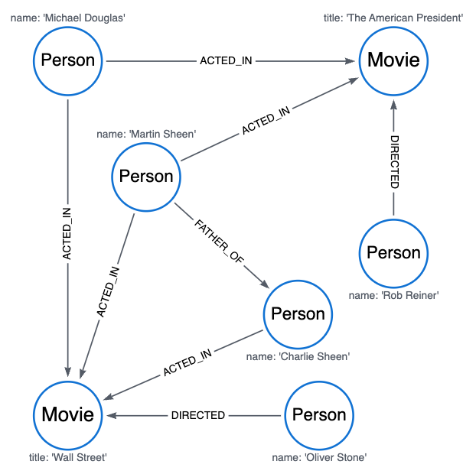
OPTIONAL MATCH Example
CREATE
(charlie:Person {name: 'Charlie Sheen'}),
(martin:Person {name: 'Martin Sheen'}),
(michael:Person {name: 'Michael Douglas'}),
(oliver:Person {name: 'Oliver Stone'}),
(rob:Person {name: 'Rob Reiner'}),
(wallStreet:Movie {title: 'Wall Street'}),
(charlie)-[:ACTED_IN]->(wallStreet),
(martin)-[:ACTED_IN]->(wallStreet),
(michael)-[:ACTED_IN]->(wallStreet),
(oliver)-[:DIRECTED]->(wallStreet),
(thePresident:Movie {title: 'The American President'}),
(martin)-[:ACTED_IN]->(thePresident),
(michael)-[:ACTED_IN]->(thePresident),
(rob)-[:DIRECTED]->(thePresident),
(martin)-[:FATHER_OF]->(charlie)

Slide 76
OPTIONAL MATCH Example
MATCH (a:Person {name: 'Martin Sheen'})
MATCH (a)-[r:DIRECTED]->()
RETURN a.name, r
(no changes, no records)
MATCH (a:Person {name: 'Martin Sheen'})
OPTIONAL MATCH (a)-[r:DIRECTED]->()
RETURN a.name, r
a.Name r
"Martin Sheen" <null>

Slide 77
OPTIONAL MATCH Example
MATCH (a:Person {name: 'Charlie Sheen'})
OPTIONAL MATCH (a)-->(x)
RETURN x
x
(:Movie {"title": "Wall Street"})
MATCH (a:Movie {title: 'Wall Street'})
OPTIONAL MATCH (a)-->(x)
RETURN x
x
<null>

Slide 78
OPTIONAL MATCH Example
MATCH (a:Person {name: 'Martin Sheen'})
OPTIONAL MATCH (a)-->(x)
RETURN x, x.name
x x.name
(:Person {"title":"Wall Street"}) <null>
(:Movie {"name":"Charlie Sheen"}) "Charlie Sheen"
(:Movie {"title":"The American President"}) <null>
MATCH (a:Movie {title: 'Wall Street'})
OPTIONAL MATCH (a)-[r:ACTED_IN]->()
RETURN a.title, r
a.title r
"Wall Street" <null>

Slide 79
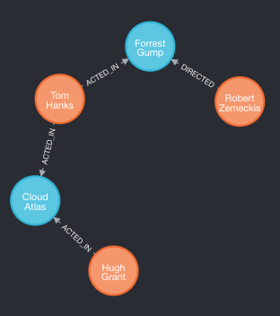
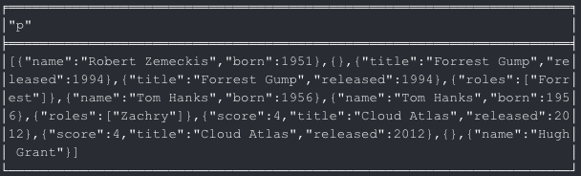
Simple Paths
Part of the MATCH
MATCH (start), (end), p = shortestPath(start-[*]-end) return p
match (start:Person{name:"Robert Zemeckis"}),
(end:Person{name:"Hugh Grant"}),
p = shortestPath((start)-[*]-(end))
return p

Slide 80
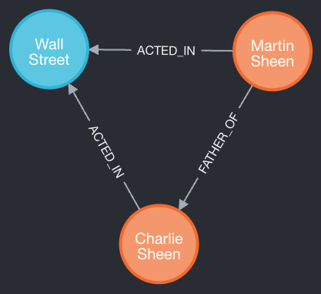
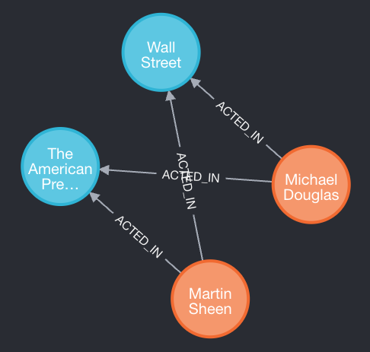
Simple Paths
shortestPath
allshortestPaths
MATCH
(charlie:Person {name: 'Charlie Sheen'}),
(martin:Person {name: 'Martin Sheen'}),
p = shortestPath((charlie)-[*]-(martin))
WHERE none(r IN relationships(p) WHERE type(r) = 'FATHER_OF')
RETURN p, length(p)
MATCH
(martin:Person {name: 'Martin Sheen'} ),
(michael:Person {name: 'Michael Douglas'}),
p = allShortestPaths((martin)-[*]-(michael))
RETURN p, length(p)

Slide 81
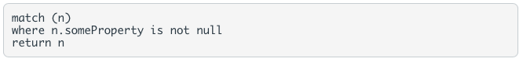
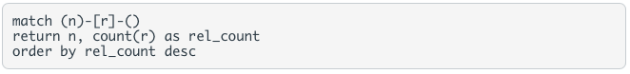
Useful Queries
Find the unique labels and relationships that appear in the database:
Find all nodes that have a specific property:
Find all nodes that have a specific relationship (regardless of the direction):
Show the nodes and a count of the number of relationships that they have:

Slide 82
Create a new network with a different type of node
CREATE
(person1:Person {name:'Alice', attitude:'Friendly'}),
(person2:Person {name:'Bob', attitude:'Scary'}),
(person3:Person {name:'Carly', attitude:'Friendly'}),
(person4:Person {name:'Dave', attitude:'Reticent'}),
(person5:Person {name:'Evelyn', attitude:'Scary'}),
(person1)-[:FRIEND_OF]->(person2),
(person2)-[:FRIEND_OF]->(person1),
(person2)-[:FRIEND_OF]->(person3),
(person3)-[:FRIEND_OF]->(person2),
(person3)-[:FRIEND_OF]->(person4),
(person4)-[:FRIEND_OF]->(person3),
(person4)-[:FRIEND_OF]->(person5),
(person5)-[:FRIEND_OF]->(person4),
(company1:Company {Name:'Enron'}),
(company2:Company {Name:'AT&T'}),
(person1) -[:WORKS_AT {tenure:7}]->(company1),
(person2) -[:WORKS_AT {tenure:12}]->(company2),
(person5) -[:WORKS_AT {tenure:3}]->(company2);

Slide 83
Explore the new network
MATCH (p1:Person {name:"Evelyn"}),(c1:Company {Name:"Enron"}),
p=shortestPath((p1)-[*]-(c1))
RETURN p
MATCH (p:Person {attitude:'Friendly'}) RETURN p
MATCH (p:Person {attitude:'Scary'}) RETURN p
MATCH (n) -[rel:WORKS_AT]->(c:Company {Name:"AT&T"}) RETURN n,c;
MATCH (n) -[rel:WORKS_AT]->(c:Company {Name:"AT&T"}) RETURN AVG(rel.tenure)

Slide 84
Indexing a Graph?
Graphs are their own indexes!
But sometimes we want short-cuts to well-known nodes
Can do this in our own code
Just keep a reference to any interesting nodes
Indexes offer more flexibility in what constitutes an “interesting node”

Slide 85
No free lunch
Indexes trade read performance for write cost
Just like any database, even RDBMS
Don’t index every node!
(or relationship)
Notes:
Just index key nodes – the pillars or themes that underpin your domain
In Doctor Who, we index the main characters and planets, and species since these are good starting nodes for traversals.

Slide 86
Lucene
The default index implementation for Neo4j
Default implementation for IndexManager
Supports many indexes per database
Each index supports nodes or relationships
Supports exact and regex-based matching
Supports scoring
Number of hits in the index for a given item
Great for recommendations!

Slide 87
Indexes
CREATE INDEX example_index_1 FOR (a:Person) ON (a.name)
Following queries will automatically use the index
Use SHOW INDEXES to see what indexes are defined
Constraints
make sure that the data adheres to the rules
CREATE CONSTRAINT constraint_example_1 FOR (movie:Movie) REQUIRE movie.title IS UNIQUE
Use SHOW CONSTRAINTS to see what constraints are defined

Slide 88
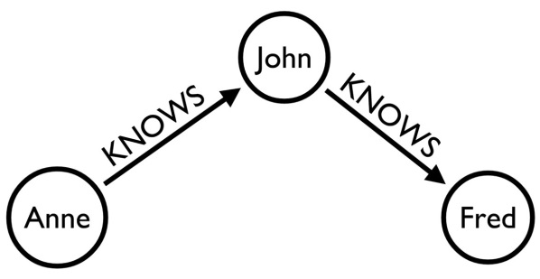
Loading Data from CSV
Understand your graph model
CSV files
people.csv 1,"John" 10,"Jane" 234,"Fred" 4893,"Mark" 234943,"Anne"
friendships.csv 1,234 10,4893 234,1 4893,234943 234943,234 234943,1
Run the following Cypher queries:
CREATE CONSTRAINT unique_id FOR (p:Person) REQUIRE p.userId IS UNIQUE;
LOAD CSV WITH HEADERS FROM "file:////Users/snell/classes/BigData/neo4j/people.csv" as row
MERGE (p:Person {Id: row.Id, name:row.Name});
LOAD CSV WITH HEADERS FROM "file:////Users/snell/classes/BigData/neo4j/friendships.csv" as row
MATCH (p1:Person {Id:row.Id1}), (p2:Person {Id:row.Id2})
CREATE (p1)-[:FRIENDS_WITH]->(p2)
CREATE INDEX ON :Person(name)
Check the results:
MATCH (:Person {name:"Anne"})-[:FRIENDS_WITH*2..2]-(p2) RETURN p2.name, count(*) as freq ORDER BY freq DESC
(p1:Person {userId:10,name:"Anne"})-[:KNOWS]->(p2:Person {userId:123,name:"John"})
https://dzone.com/articles/how-neo4j-data-import-minimal
Notes:
https://dzone.com/articles/how-neo4j-data-import-minimal
All second degree friends of “Anne” and on how many ways they can be reached

Slide 89
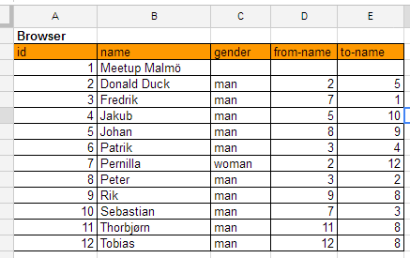
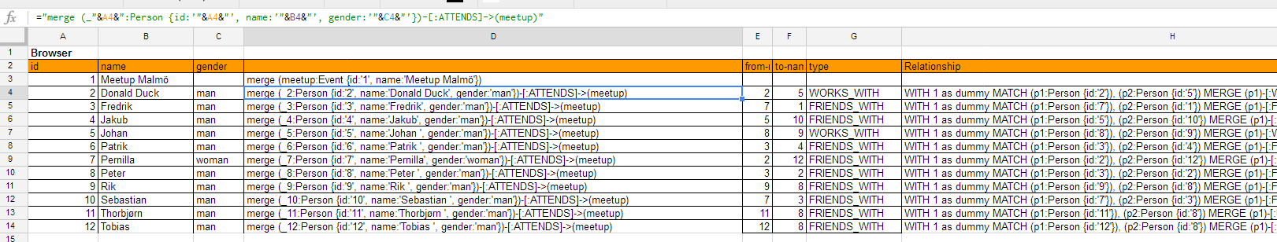
Loading Data from a Spreadsheet
Lay out your data in a spreadsheet
Use formulas to generate the required Cypher statements
Collect Cypher queries and run them
Check the results:
MATCH (p1:Person)-[:ATTENDS]-(e:Event{name:"Meetup Malmö"})-[:ATTENDS]-(p2:Person) WHERE (p1)-[:FRIENDS_WITH]-(p2) RETURN p1, p2, e;
Based on a blog post by Rik Van Bruggen (https://neo4j.com/blog/importing-data-into-neo4j-the-spreadsheet-way/)
Notes:
https://neo4j.com/blog/importing-data-into-neo4j-the-spreadsheet-way/
All people attending the event at Malmö who have at least one friend also attending this event.

Slide 90
Loading Data from a GraphML file
Use neo4j-shell-tools from https://github.com/jexp/neo4j-shell-tools
Populate the database from a GraphML file
import-graphml -i /usr/share/neo4j/import/airlines.graphml -r HAS_DIRECT_FLIGHTS_TO -b 20000 -c -t
Check the results:
MATCH (a)--()
WITH a.tooltip as airport, count(*) as flights
RETURN airport, flights ORDER BY flights DESC LIMIT 10

Slide 91
Deeper Dive

Slide 92
DEEPER Dive into graph databases
Graph Modeling Guidelines:
The query patterns drive the data model
Normalization is a natural trend in graph modeling
In general normalization has a low cost
Complexity with normalization will drive traversal speeds up
Consider creating a node rather than a property in a node and create relationships
Node and Relationship Redundancy is not necessarily bad.
Schema development over time
Notes:
1st Rules, 2nd Guidelines
I searched for Graph Modeling Rules. I found zero. No big deal after all it’s fairly new. Then I found “The Rule” during my research. “The Rule” almost made me drop any consideration I had for implementing a graph database. I will show you what I consider the primary rule, and then I will tell you what “The Rule” is. As Graph Modeling matures I’m sure they will remove “The Rule” in future documentation.
Don’t go overboard with redundancy. If you find that you are apply redundancy to solve the majority of design issues then I would re-evaluate.
In-graph indices: In stead of creating a property on a node… That property would become a node, and create relationships
Looking through these rules you will see that it is not for lists.
Database extensions: New logic over old portion of the schema.

Slide 93
DEEPER Dive into graph databases
Graph Modeling Dilemmas:
Q: Should I create a Relationship or a Property?
Q: Should every node with the same key/value (property) be connected?
A: It depends.
If you need to connect something modeled as a relationship to more than two other entities,
then you have to refactor the entity inside the relationship out into a separate node.
Notes:
1st Rules, 2nd Guidelines, 3rd Gotchas
If you need to connect something modeled as a relationship to more than two other entities, then you have to refactor the entity inside the relationship out into a separate node. This a break change to the data model. Changes to queries and applications will be needed.1

Slide 94
DEEPER Dive into graph databases
DESIGN PATTERNS
Linked List
Multiple Relationships
Tags and Categories
Multi Level Tree
R-Tree (spatial)
Activity Stream
Anti-pattern: Unconnected graph
Notes:
1st Rules, 2nd Guidelines, 3rd Gotchas, 4th Patterns
This is so easy! (My seamless moment)

Slide 95
DEEPER Dive into graph databases
Anti-pattern
Pattern: Linked List
Link up entities/nodes
Notes:
Is there a pattern of lists that results in more medals?

Slide 96
DEEPER Dive into graph databases
Anti-pattern
Pattern: Multiple Relationships
Relationships have properties
Entities/Nodes can be used for multiple people

Slide 97
DEEPER Dive into graph databases
Anti-pattern
Pattern: Tags and Categories

Slide 98
DEEPER Dive into graph databases
Pattern: Multi-Level Tree
Notes:
You will remove large portions of the graph by following a single relationship path.
You can also take advantage of the cache and hold section of the tree in memory.

Slide 99

DEEPER Dive into graph databases
Use spatial relationships to create a tree. Traversal of the tree prunes large chunks of space.
Notes:
You will remove large portions of the graph by following a single relationship path.
You can also take advantage of the cache and hold section of the tree in memory.

Slide 100

DEEPER Dive into graph databases
Pattern: Stream Analysis⁵
http://blog.bruggen.com/2013/11/clickstreams-are-so-much-nicer-in-neo4j.html

Slide 101
Deeper dive into graph databases
Fine-Grained Relationships
Generic Relationships
Consider the tradeoffs of fine-grained relationships vs. generic that are qualified with properties
Another example: DELIVERY_ADDRESS, HOME_ADDRESS, etc. versus ADDRESS [type: ‘delivery’ or ’home’]
Notes:
Trade-offs between using fine-grained relationship lables versus generic relationships qualified with properties. DELIVERY_ADDRESS, HOME_ADDRESS, etc. versus ADDRESS [type: ‘delivery’,’home’]1

Slide 102
Common Use Cases
Social
Recommendations
Geo
Master Data Management
Network & Data Center Mgmt
Authorization and Access Control

Slide 103
Logistics use case
Multiple Picks/Drops
Carriers need to optimize
Make multiple pickups
Make multiple drop-offs
Numerous Examples
Supply Chain Management
Notes:
Semi-trucks: Live expectancy is 7 years.

Slide 104
Logistics use case
This works but the data structure is not very expressive
Notes:
Through in shipper / multiple shipper. Sure you can create it, but the data structure is not expressive at all.

Slide 105
Logistics use case

Slide 106
Security use case
Authorization & Access Control
“Ensure that users and administrators see and change only those parts of the organization and the products and services they are entitled to manage.”
Notes:
Pulled directly from the neo4j book on graphdatabase. See references at end of slide deck.

Slide 107

“This model comprises two hierarchies. The first hierarchy, admins within each customer organization are assigned to groups; these groups are then granted various permissions against that organization’s structure.”

Slide 108
Other uses of graph databases
Analyzing the Panama Papers leaked dataset
https://linkurio.us/blog/panama-papers-how-linkurious-enables-icij-to-investigate-the-massive-mossack-fonseca-leaks/
Analyzing BuzzFeed Trump World dataset
https://neo4j.com/blog/buzzfeed-trumpworld-dataset-neo4j/
Financial Fraud Detection
https://www.sciencedirect.com/science/article/pii/S1361372320300737
The Flavor Network
https://www.nature.com/articles/srep00196

Slide 109
Points to consider
When to use a graph database
Is my data highly connected?
Is retrieving data quickly more important than writing?
Does my data/schema change often?
When not to use a graph database
Do my queries often not include a specific starting point?
Do I have frequent table scans?
Do my queries often just need key/value lookup?
Is my data mostly just large chunks of information
Consider using both relational DBs and Graph DBs
For example, implement hierarchy in graph and store employee information in relational tables.

Slide 110
Ops and Big Data
Neo4j in Production, in the Large

Slide 111
Two Challenges
Operational considerations
Data should always be available
Scale
Large dataset support

Slide 112
Neo4j HA
The HA component supports master-worker replication
For clustering
For data replication across sites
Notes:
The HA component uses log shipping under the covers to ensure eventual consistency across database instances
We use Zookeeper to elect cluster masters, even in the event of failure/partition (PAXOS algorithm)

Slide 113

HA Architecture
HA Mirrors
Eventual Consistency
ZooKeeper is used to elect a new Master if the Master fails.

Slide 114

Write to a Master
Writes to the master are fast
And workers eventually catch up

Slide 115

Write to a Worker
Writes to a worker cause a synchronous transaction with the master
And the other workers eventually catch up

Slide 116
Backup & Disaster Recovery

Slide 117
Scaling graphs is hard
Notes:
Not all databases need to be Facebook scale.
Most enterprise deployments have much more modest usage.

Slide 118

“Black Hole” server
Notes:
The black-hole problem: popular nodes get lumped together on a single instance, but there is low point cut

Slide 119

Chatty Network
Notes:
Load-leveling alone can lead to many relationships crossing instances.
These are very expensive to traverse, networks are many orders of magnitude slower than in-memory traversals

Slide 120

Minimal Point Cut
This is still an open research area. Graphs are highly mutable and so these algorithms face an uphill fight, even if we could get them right.
Unlike other NoSQL stores, graphs simply aren’t predictable, and so we can’t use techniques like consistent hashing for scale out.
Notes:
There are well-known algorithms that help with keeping graphs balanced (the Minimum Point-Cut problem)
They can work at
- insert-time
- periodically
Each has different properties, but good ones take a local view of the graph (no global locks) and work incrementally (short bursts).
They can even take into account use patterns.
But this is still an open research area. Graphs are highly mutable and so these algorithms face an uphill fight, even if we could get them right.
Unlike other NoSQL stores, graph’s simply aren’t predictable, and so we can’t use techniques like consistent hashing for scale out.

Slide 121
So how do we scale Neo4j?
Notes:
Not all databases need to be Facebook scale.
Most enterprise deployments have much more modest usage.

Slide 122
A Humble Blade
Blades are powerful!
A typical blade will contain 128GB memory
We can use most of that
If O(dataset) ≈ O(memory) then we’re going to be very fast
Remember we can do millions of traversals per second if the caches are warm
Notes:
10s of gigabytes:
Slam in the RAM on a single server and all is plain sailing
It is write scaling that is trickier with graphs, but if you’ve got an enterprise-scale or read-mostly web-scale system this might not be such a problem

Slide 123
Cache Sharding
A strategy for coping with large data sets
Terabyte scale
Too big to hold all in RAM on a single server
Not too big to worry about replicating it on disk
Use each blade’s main memory to cache part of the dataset
Try to keep caches warm
Full data is replicated on each rack

Slide 124

Consistent Routing
Notes:
Consistent Routing c.f. Consistent hashing name – means always try to route related requests to the same server to hopefully benefit from warm caches

Slide 125
Domain-specific sharding
Eventually (Petabyte) level data cannot be replicated practically
Need to shard data across machines
Remember: no perfect algorithm exists
But we humans sometimes have domain insight
Some domains naturally shard.
geo data where the connections between cities are few compared with the connections within the cities. Place cities or countries on different nodes
user content, where connections between normal users are few (modulo any celebrities).
Notes:
Some domains naturally shard.
E.g. geo where the connections between cities are few compared with the connections within the cities. So can place cities or countries on different nodes
E.g. user content, where connections between normal users are few (modulo any celebrities).
Write-scaling is not automatic with graphs

Slide 126



Other Graph Databases
ArangoDB – Multi-model database
Key-Value, Document, Graph
Amazon Neptune
OrientDB
Also Multi-model
Purchased by SAP
Apache Giraph
Built on Hadoop
GraphBase.ai
Built for knowledge graphs

